Slide 1

No-Cost or Low-Cost Options for Reuse or Disposal
In addition to the services provided by the City of Methuen and E. L. Harvey, there are a multitude of private companies that provide low- or no-cost reuse or safe disposal services that you can use to reduce curbside trash, .save the environment and support Merrimack Valley businesses. See below for the “hard to dispose of” items that can be disposed safely or reused locally at no cost or low cost. This list is not exhaustive.

Slide 2
Table of Contents
Batteries
Bicycles
Blankets
Books
Clothing/Textiles
Construction Debris
Electronics & Computer Parts
Eyeglasses
Fluorescent Light Bulbs
Ink Cartridges
Medical Aids
Metal Items & Scrap Metal
Motor Oil
Packaging Materials
Paint (Latex)
Paint (Oil)
Plastic Bags
Sharps & Needles
Tires
Unwanted or Expired Medication

Slide 3
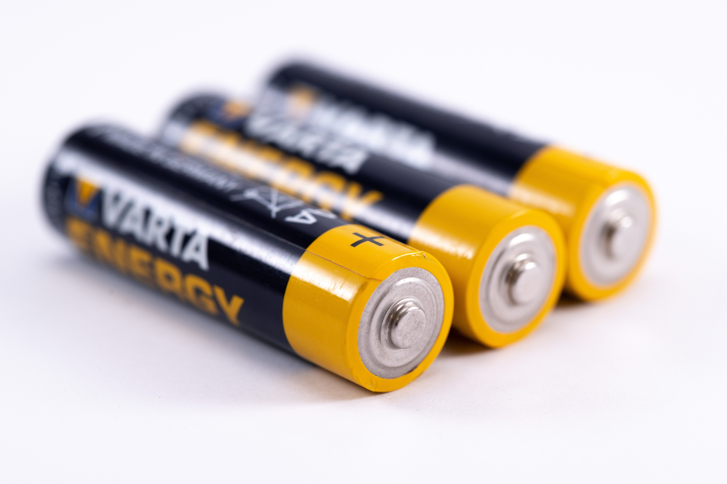
Batteries
Home Depot (72 Pleasant Valley Street, Methuen, MA) will take batteries free of charge in their drop off bin.
corporate.homedepot.com/newsroom/second-life-hard-recycle-items
Batteries & Bulbs (380 S Broadway, Salem, NH) accepts batteries for recycling.
https://www.batteriesplus.com/recycling

Slide 4

Bicycles
University of Massachusetts Lowell has a bike collection program for bikes in good condition. If you send them a photo of the bike and are within a 30 minute drive, they will come pick it up for you. If your bike is not in repairable condition, see ‘Metal Items’ and ‘Tires’ on how to dispose of the parts of a bike.
www.uml.edu/bike/bike-shop/donate.aspx

Slide 5
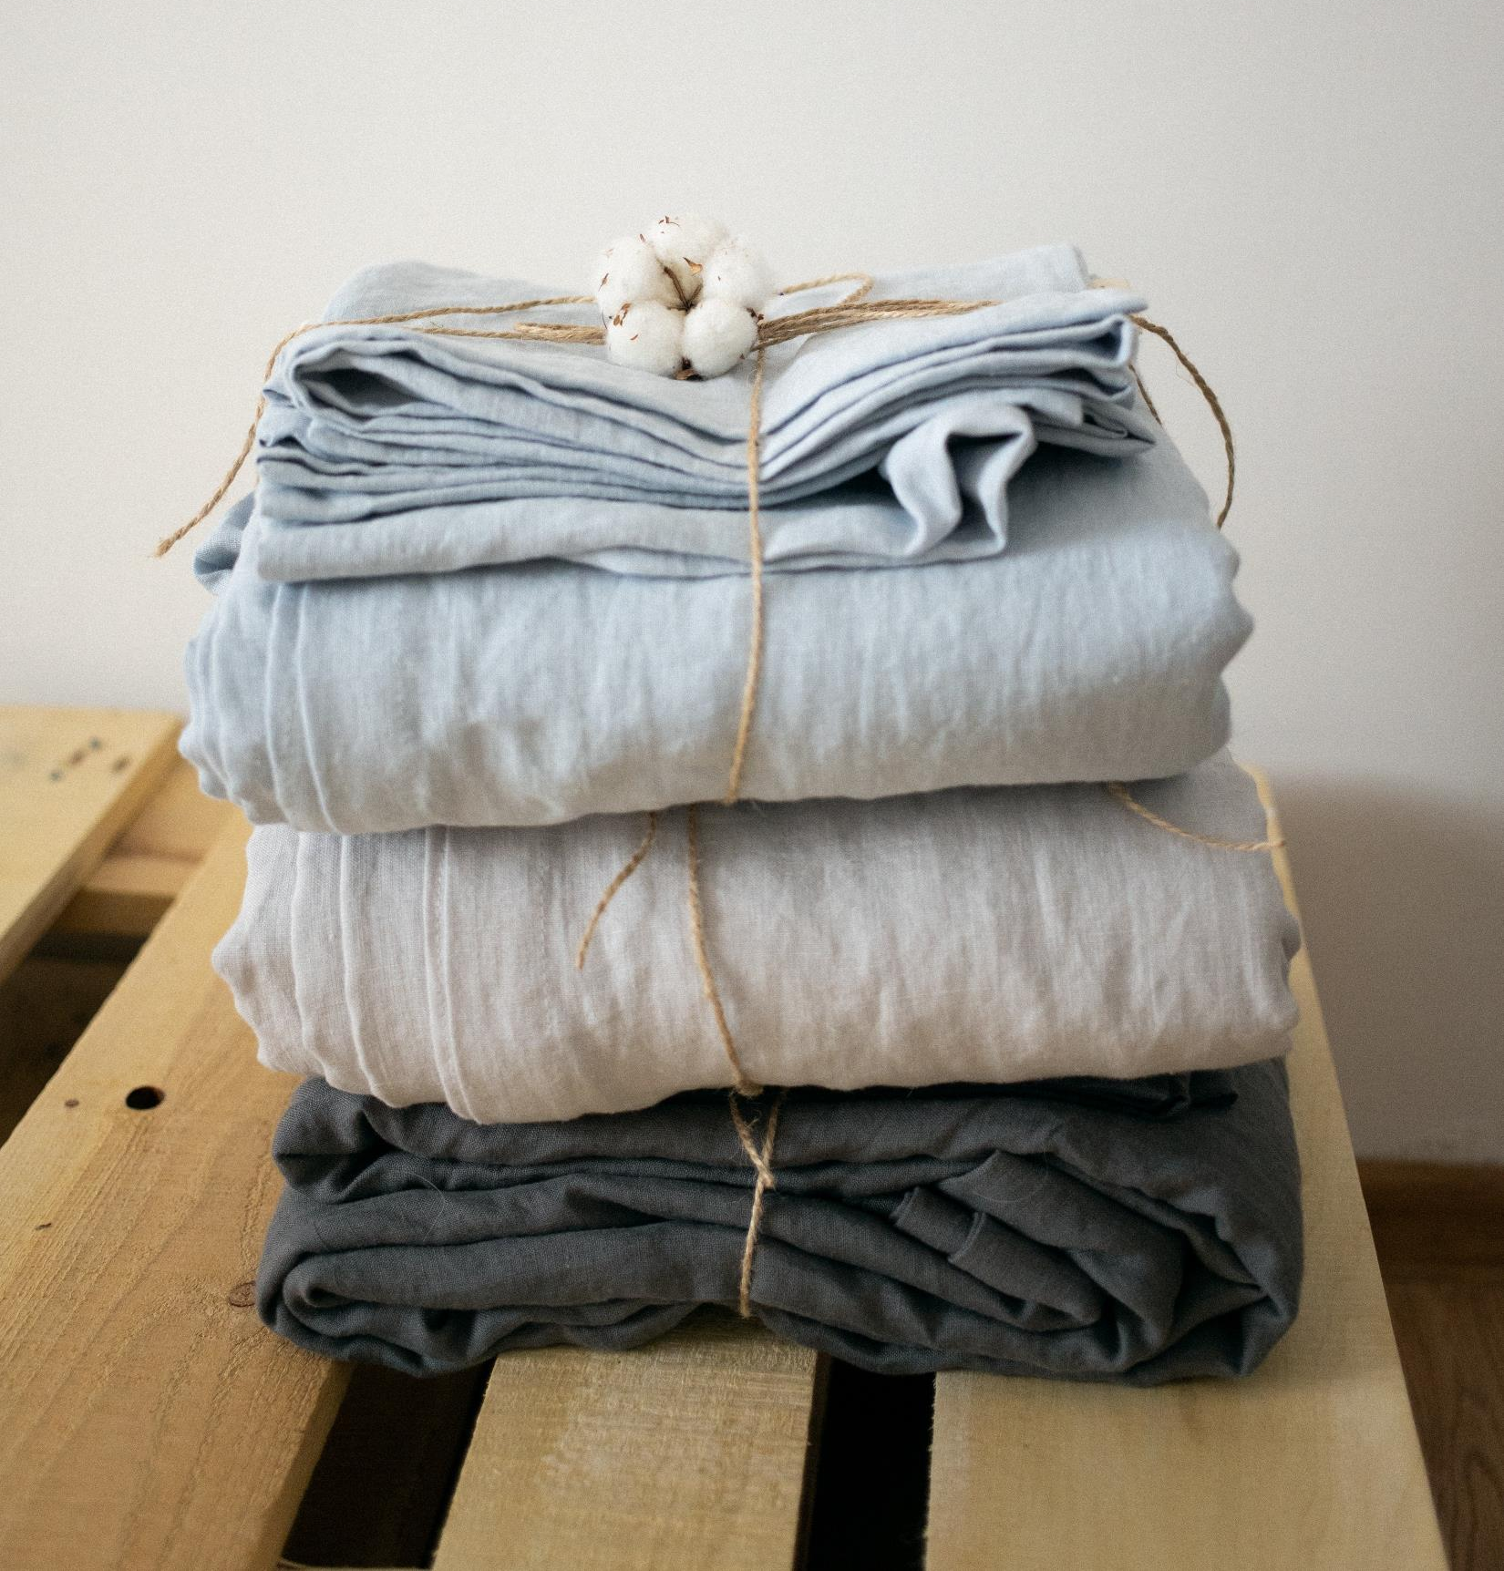
Blankets
The MSPCA at Nevins Farm (400 Broadway, Methuen, MA) takes blankets as donations for their animals.
www.mspca.org/adoption-centers/nevins-farm-adoption-center/

Slide 6

Books
If the books are in good condition (no musty or yellowed pages), the Nevins Memorial Library (305 Broadway, Methuen, MA) will accept them as donations. They will not accept magazines or encyclopedias.
The Used Book Superstore (149 S Main St, Middleton, MA) accepts books.
Bull Moose (419 S Broadway, Salem, NH) accepts books.
Also look for Little Free Library near you to drop off books.
Magazines in good condition can be donated to Memorial Hall Library (2 N Main St, Andover, MA).

Slide 7
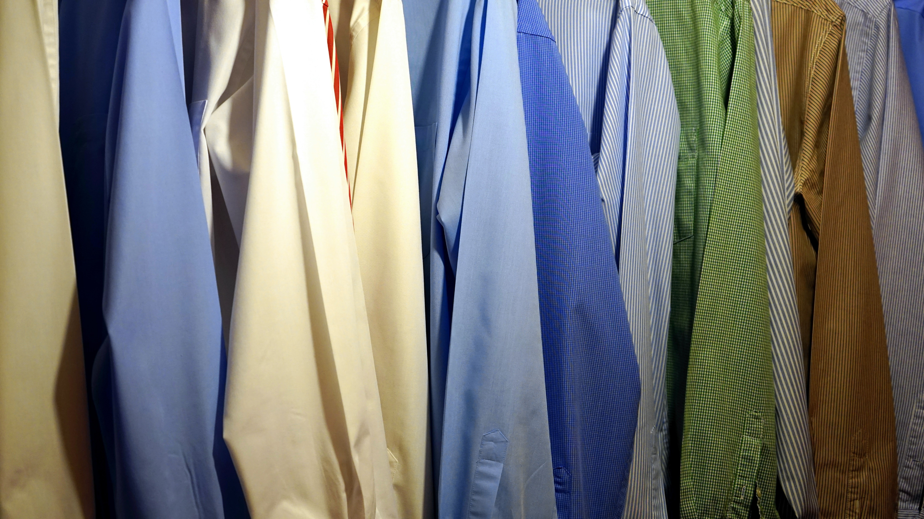
Clothing & Textiles
If the clothes are in a good condition, consider donating them to the Methuen Senior Activity Center (77 Lowell St, Methuen, MA).
Big Brother Big Sister will accept clothes in good condition, schedule a pickup and see what else they accept on their website.
www.bbbsfoundation.org/faqs/acceptable-non-acceptable-items/
Lazarus House (229 South Union Street, Lawrence, MA) accepts clothing in good condition. Also, they accept various household items. Please see their website for more information.
https://lazarushouse.org/services/clothing/
Ruth's House (111 Lafayette Square, Haverhill, MA) accepts clothes in good condition along with other items.
https://www.ruthshouse.org/take-action/#donate-clothing-household
The Andover Thrift Store (10 Park St, Andover, MA) accepts clothes in good condition. They also accept other items, and have ceratin windows for donations. Please check their website for the times along with the list of items.
https://andoverthriftshop.com/donations/
Share the Love (85 Main St, North Andover, MA) accepts women’s clothes and accessories by appointment only.
https://sharetheloveconsignment.com/
Children’s Orchard (225 Newburyport Turnpike, Rowley, MA) will buy children’s clothes from you, but they must fit certain criteria. Please check their website first.
https://rowleyma.childrensorchard.com/pages/sell-to-us

Slide 8
Clothing & Textiles (cont’d)
You can also drop off textiles at one of the yellow “clothes and shoes” bins. The yellow bins accept all textiles unless they are dirty, wet, or moldy. This means they accept bedding, towels and torn fabrics as well.
North Fire Station at 250 Howe Street
Vana Mart at 163 Swan Street
A&B Package Store at 161 Pelham Street
Galloways Convenience at 176 at Pelham Street
Rt. 97 House of Pizza at 11 Ayers Village Road
George’s Bakery at 26 Spruce Street
YMCA at 129 Haverhill Street
Haven of Hope at 76 Union Street
Merrimack Plaza Mobil at 214 Haverhill Street
Salvation Army bin at Methuen Transfer Station (50 Huntington Ave, Methuen, MA)
Methuen public schools all have Bay State Textile bins that raise money for school programs based on tonnage of textile material collected. Most forms of textiles are accepted as long as they are clean. For specific questions on what to donate visit their website
Methuen High School (1 Ranger Rd, Methuen, MA)
Marsh Grammar School (309 Pelham St, Methuen, MA)
Comprehensive Grammar School (100 Howe St, Methuen, MA)
Donald P Timony Grammar School (45 Pleasant View St, Methuen, MA)
Tenney Grammar School (75 Pleasant St, Methuen, MA)
Central School Admin Building (10 Ditson Place)
www.baystatetextiles.com

Slide 9
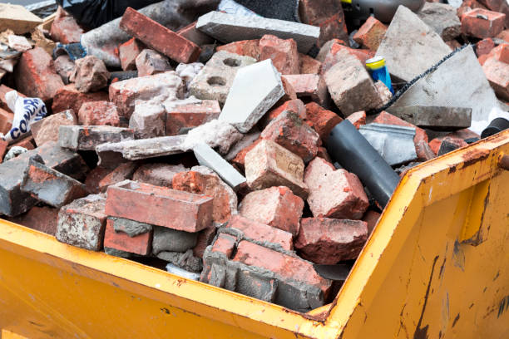
Construction Debris
An alternative to the Methuen Transfer Station for disposal of construction debris is the Agretech Corp. facility at 50 Jackson Street in Dracut, MA. Agretech accepts asphalt, bricks, and concrete for reuse at a fee. https://agretechcorp.com/disposal/

Slide 10
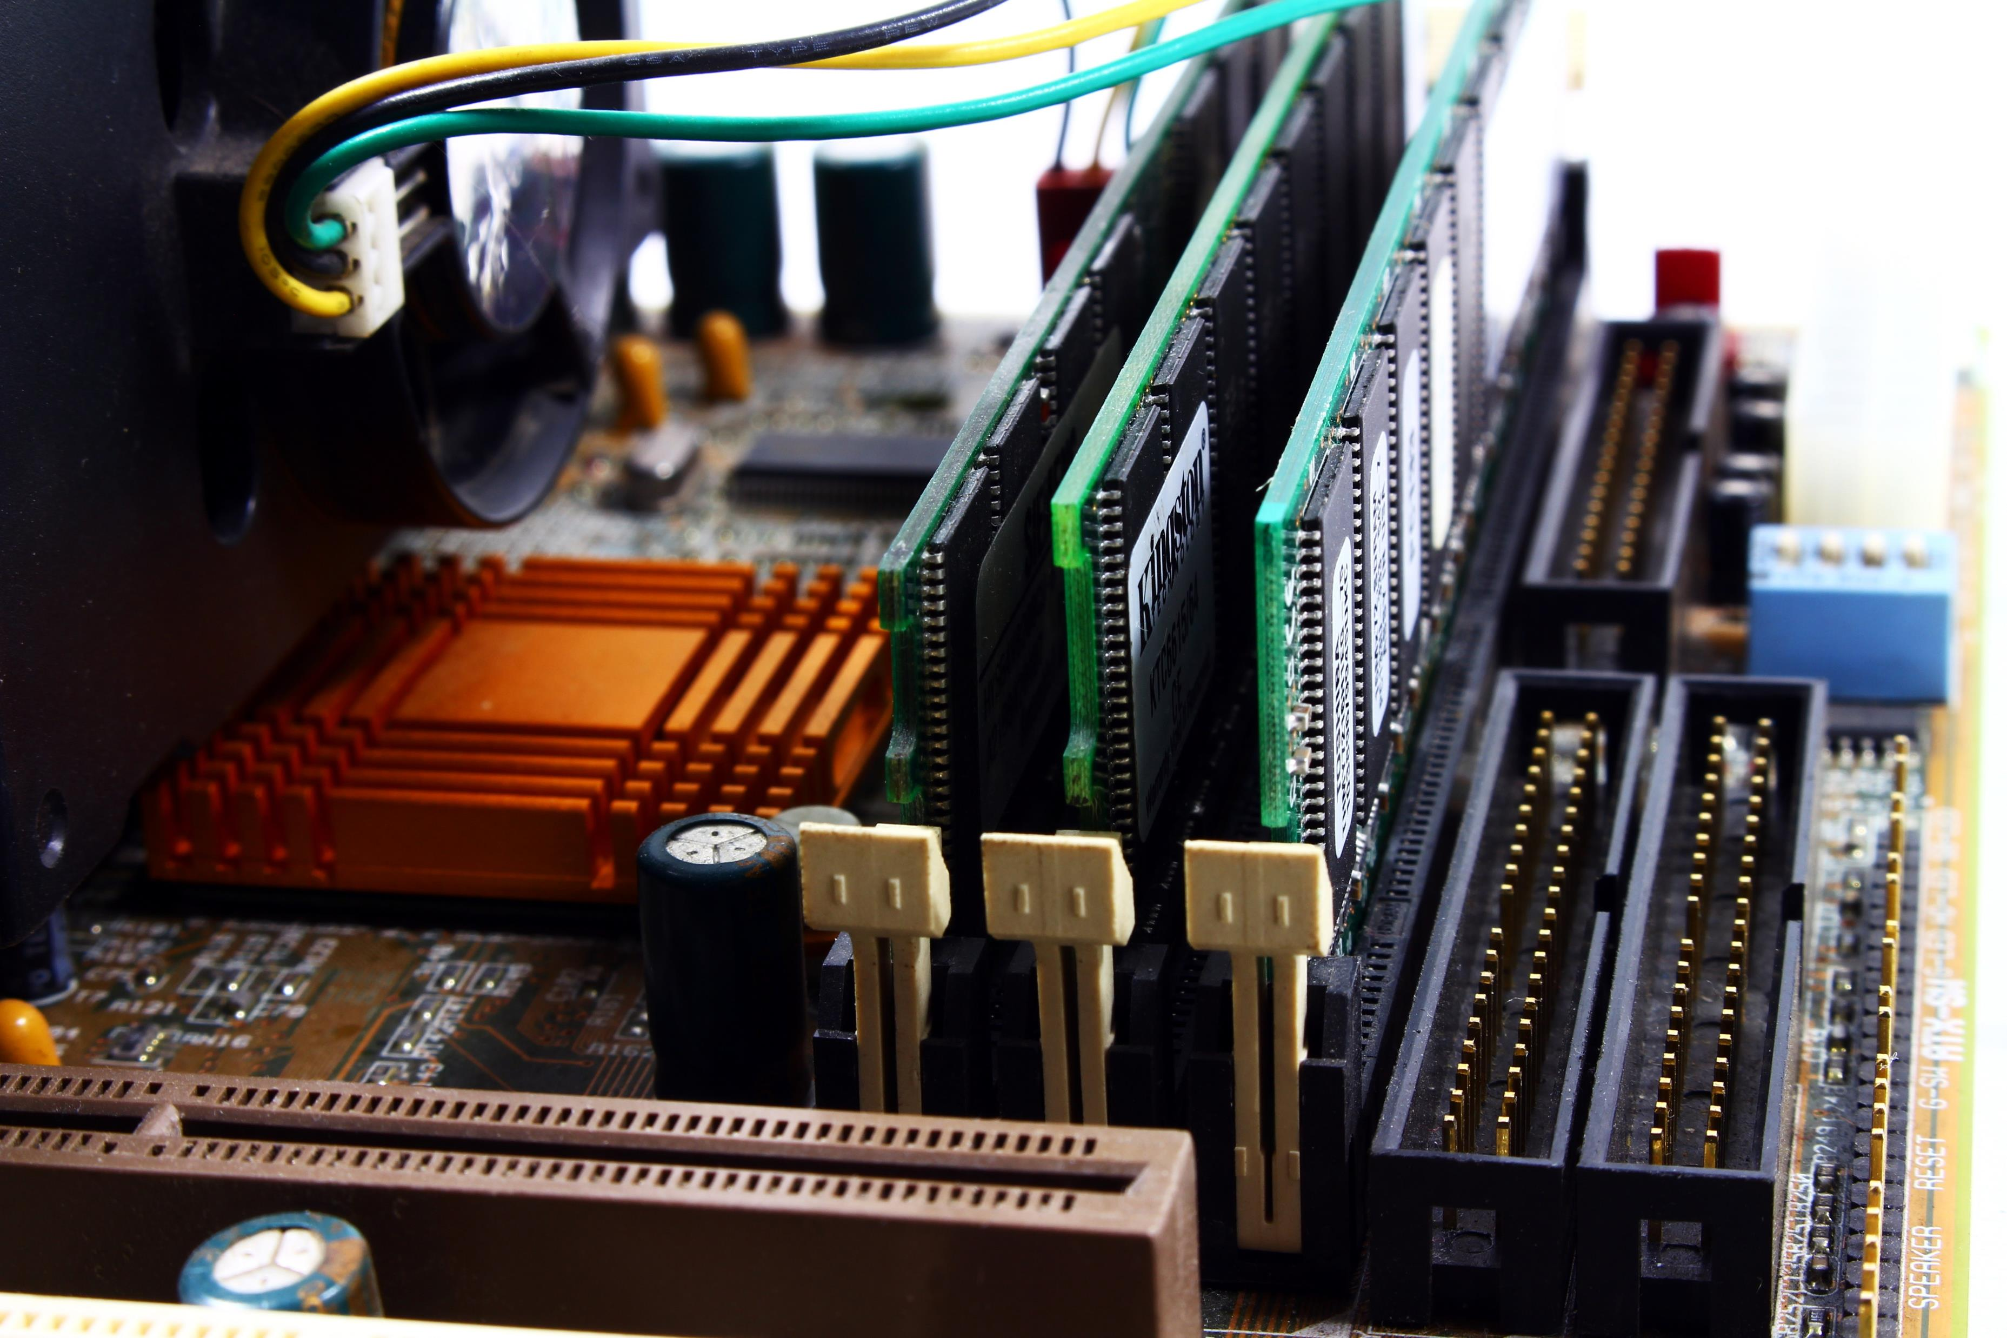
Electronics and Computer Parts
Best Buy (290 S Broadway E, Salem, NH) accepts up to 3 items per households per day free of charge.
www.bestbuy.com/site/services/recycling/pcmcat149900050025.c?id=pcmcat149900050025
Staples also accepts many electronic devices, up to 7 per customer per day.
Electronics Recycling | Sustainability | Staples®
Cell Phones are also taken at Target (67 Pleasant Valley Street, Methuen, MA) for recycling.
Batteries & Bulbs (380 S Broadway, Salem, NH) accepts some electronics for recycling.
https://www.batteriesplus.com/recycling

Slide 11
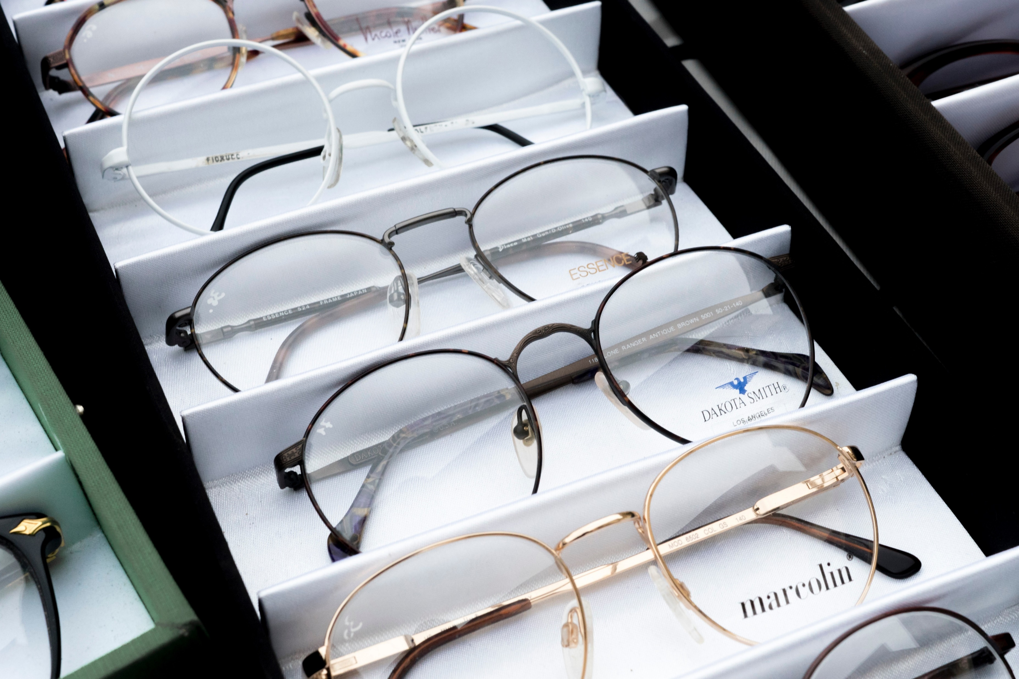
Eyeglasses
Any Walmart that has a Walmart Vision Center (326 N Broadway, Salem, NH) are partnered with Lions Club, to collect donations of old eyeglasses.
Pearle Vision at the Loop (90 Pleasant Valley St #250, Methuen, MA) has a donation box for the collection of corrective glasses.
Nevins Memorial Library (305 Broadway, Methuen, MA) also has a drop off bin for eyeglasses.

Slide 12
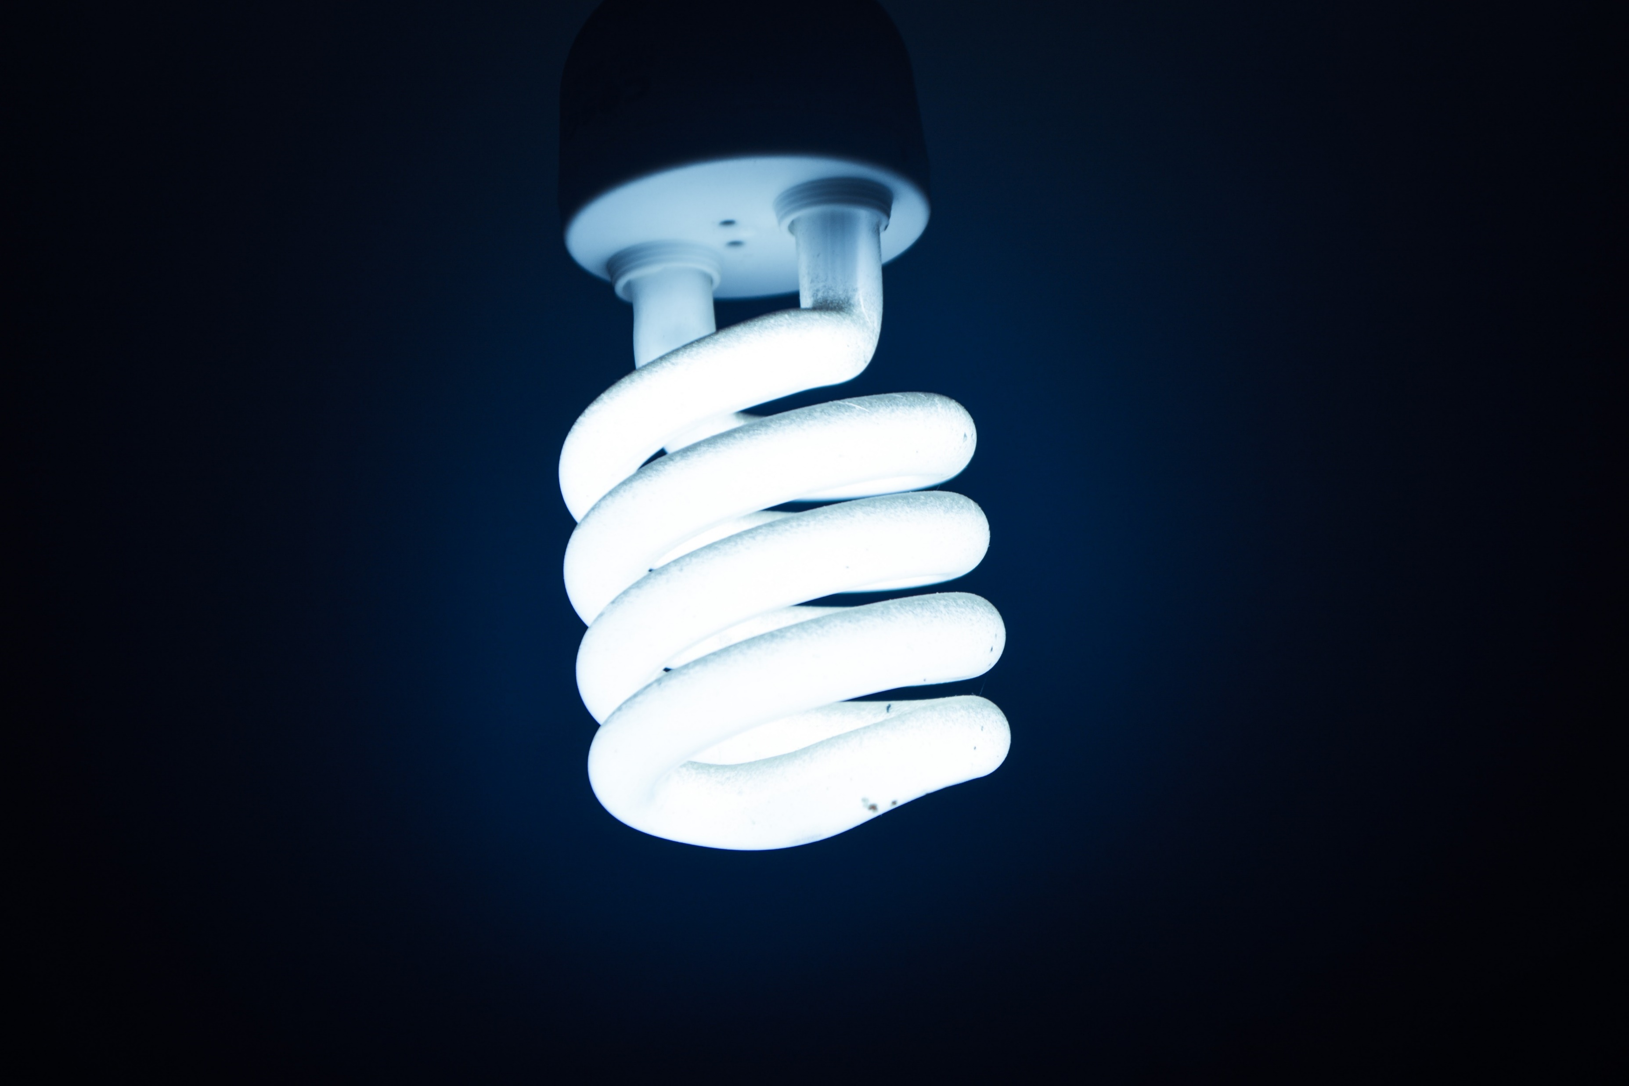
Fluorescent Light Bulbs
The Home Depot (72 Pleasant Valley Street, Methuen, MA) accepts fluorescent bulbs for recycling free of charge in their drop off bin.
corporate.homedepot.com/newsroom/second-life-hard-recycle-items
Batteries & Bulbs (380 S Broadway, Salem, NH) accepts all sorts of light bulbs, see their website for specifics.
https://www.batteriesplus.com/recycling

Slide 13
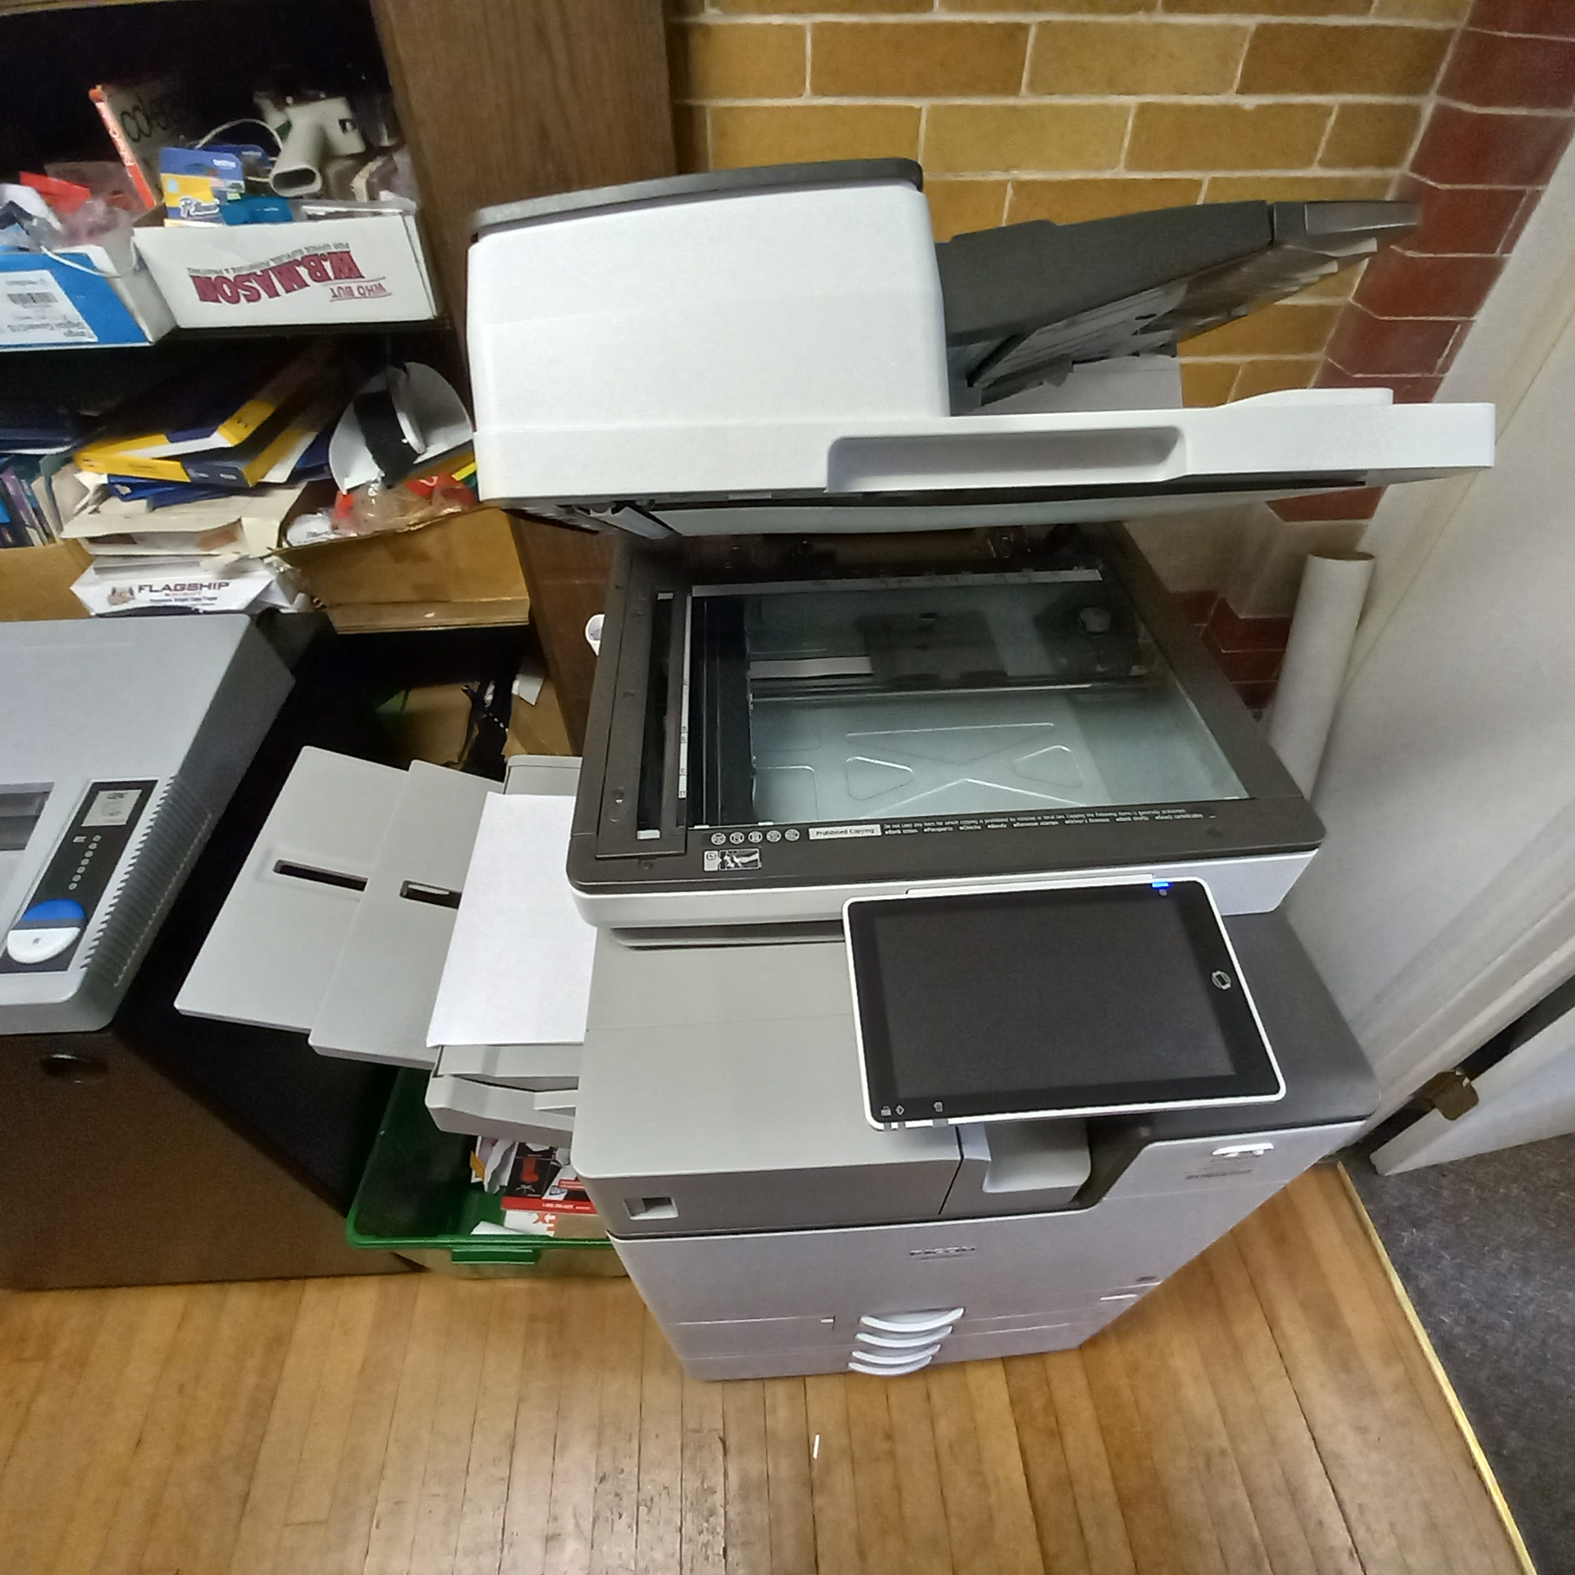
Ink Cartridges
If you would like your ink cartridge refilled, Walgreens will refill for cheaper than of buying new ones.
Staples will take ink cartridges for recycling free of charge.

Slide 14
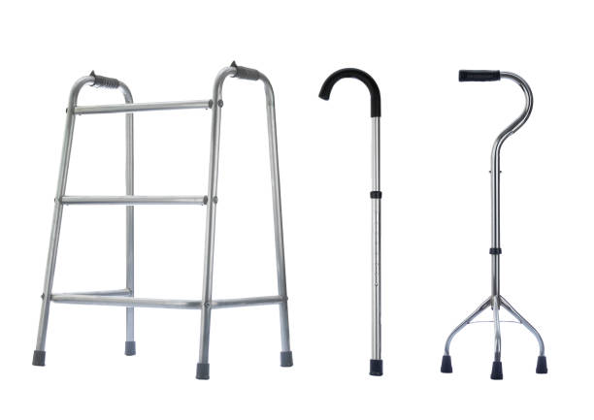
Medical Aids
Freemasons Hospital Equipment Loan Program (500 W Cummings Park, Woburn, MA) accepts medical equipment for at home care. See their website for what they accept.
https://smd-help.org/
Methuen Senior Center at 77 Lowell St. also accepts donations for reuse of wheelchairs and canes.

Slide 15
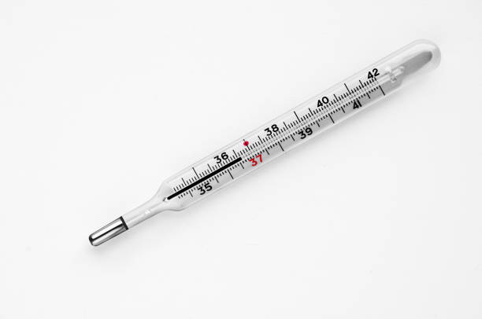
Mercury Items (Thermometers)
The city collects mercury products at the Board of Health in City Hall (2nd Floor, 41 Pleasant Street). Items accepted include thermometers, button batteries containing mercury, and thermostats.
www.cityofmethuen.net/sites/g/files/vyhlif886/f/file/file/mercury2013.pdf

Slide 16
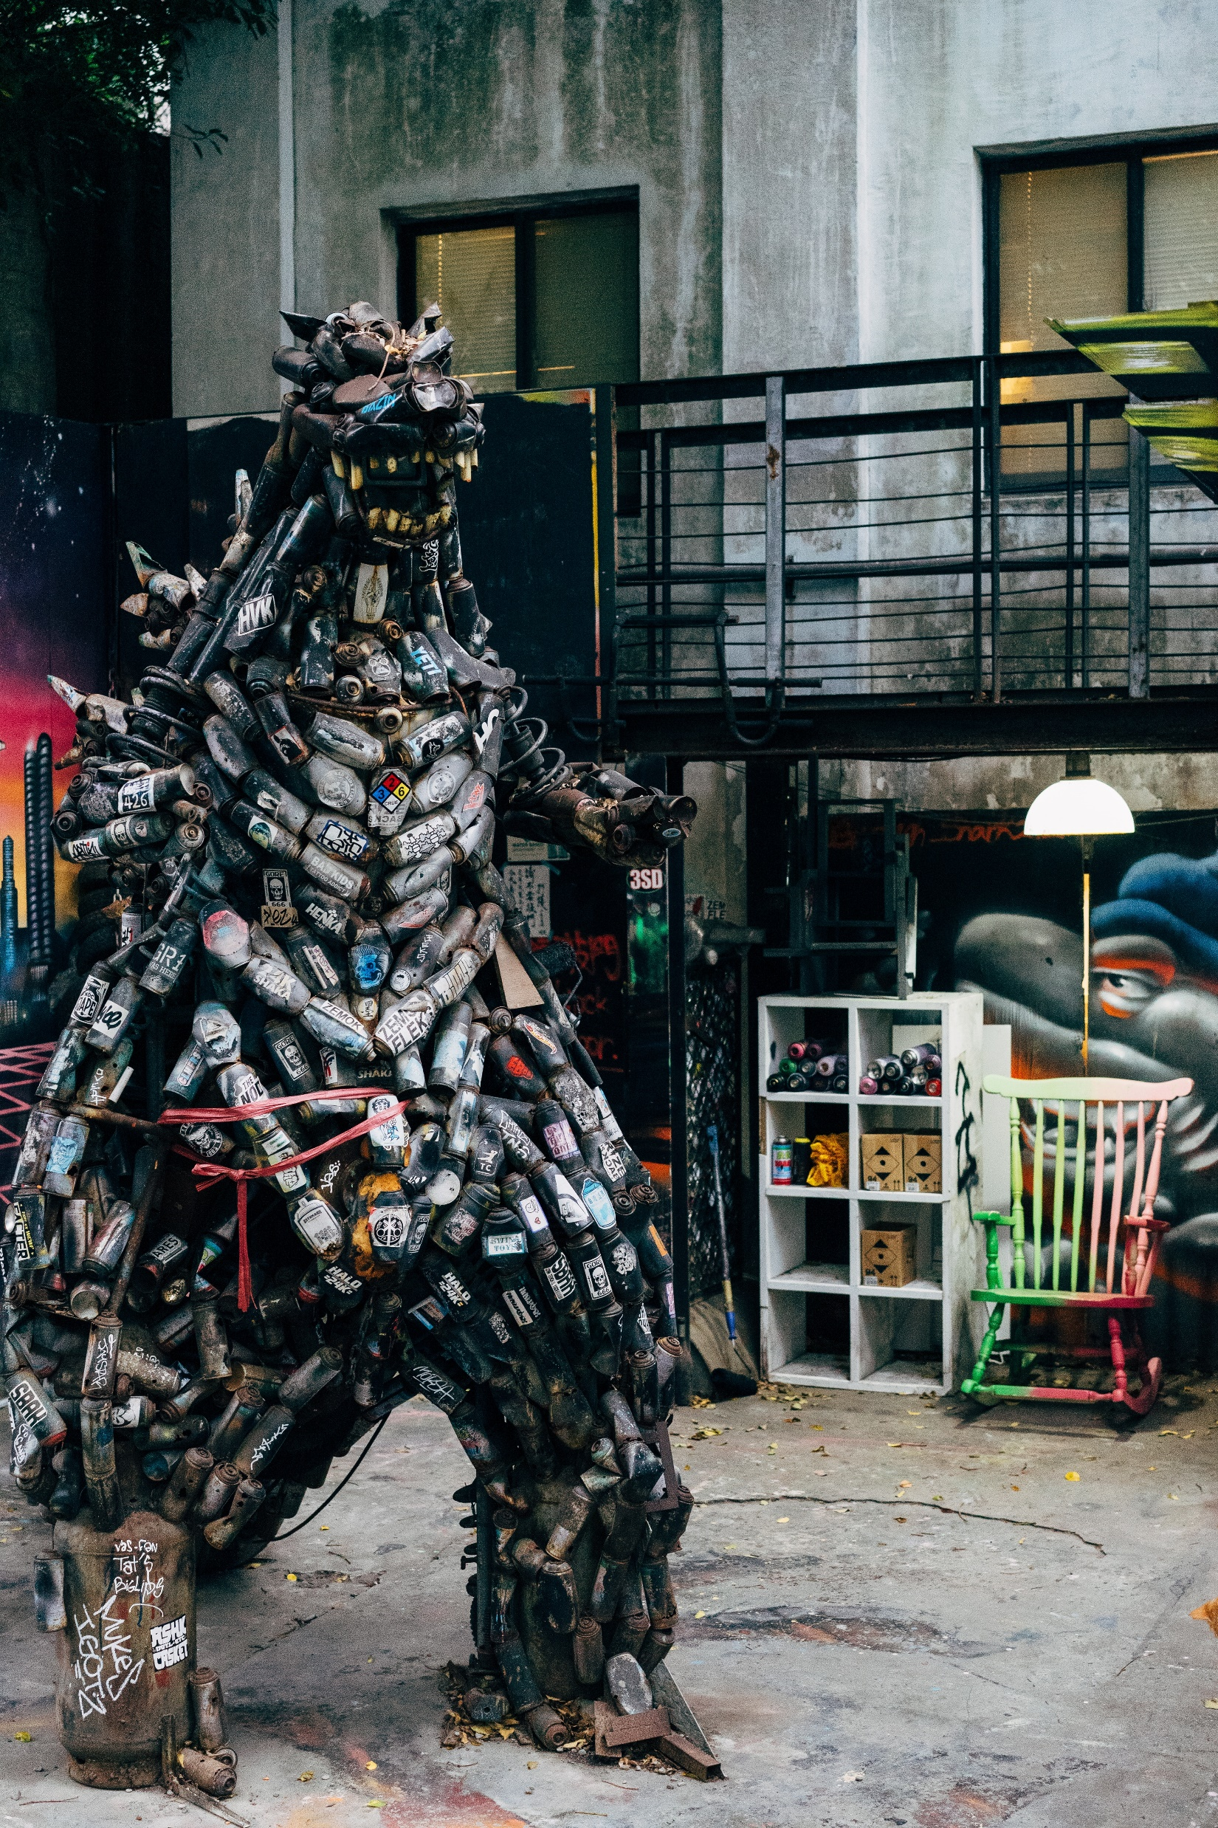
Metal Items & Scrap Metal
Windfield Alloy Inc. will take scrap metal usually free of charge.
windfieldalloy.com/contact/hours-of-operation/

Slide 17
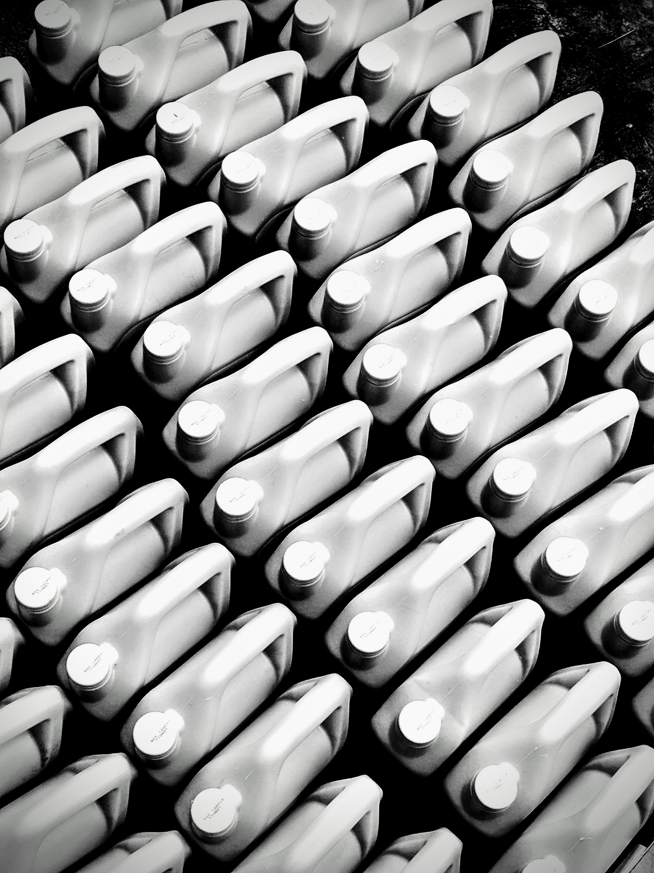
Motor Oil
According to Massachusetts State Law, any business that sells motor oil must accept used motor oil back – with a receipt or proof of purchase.

Slide 18
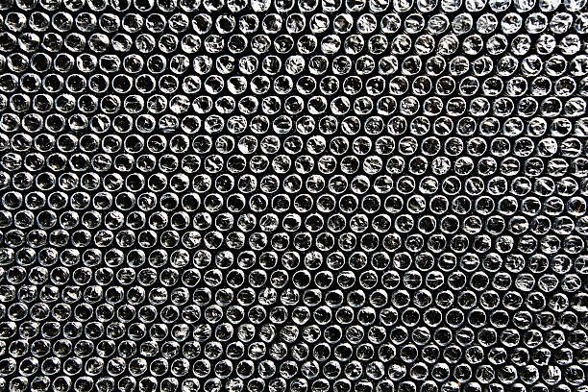
Packaging Materials
The Methuen Post Office (272 Broadway, Methuen, MA) accepts packaging materials.

Slide 19
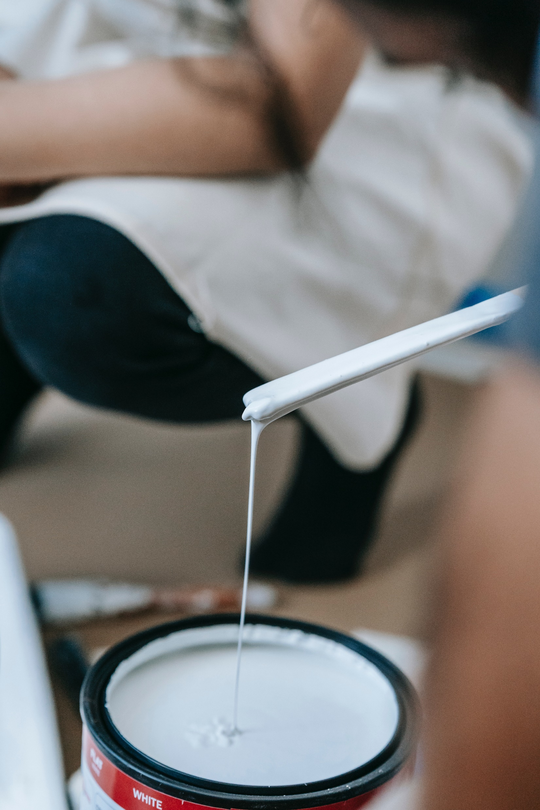
Paint (Latex)
Latex paint can be thrown away in standard trash collection once it is dry. To ensure it is dry, pour it out in a small portion and wait for it to dry. After one portion has dried, pour the next portion and repeat until it is all dry. An alternative way is to put sawdust, kitty litter, or another absorbent material to dry out the paint faster.

Slide 20

Paint (Oil)
On Methuen’s Hazardous Waste Day (See date on website) and other regional Hazardous Waste Events open to Methuen residents, oil paint is accepted.
www.cityofmethuen.net/hazardouswasteday

Slide 21
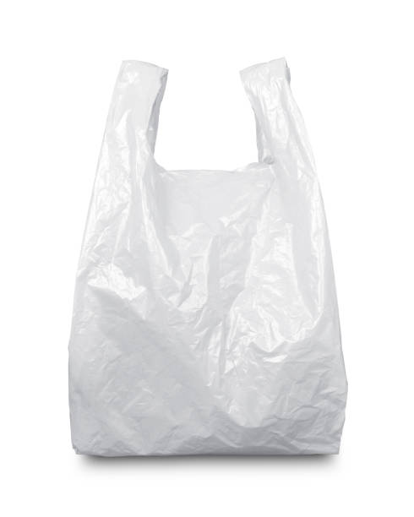
Plastic Bags
The Home Depot (72 Pleasant Valley Street, Methuen, MA) accepts plastic bags for recycling free of charge in their drop off bin.
Market Basket accepts plastic bags for recycling free of charge.
Walmart(70 Pleasant Valley Street, Methuen, MA) accepts plastic bags for recycling.
Target (67 Pleasant Valley Street, Methuen, MA) also recycles plastic bags.
You may also check for other nearby stores at https://bagandfilmrecycling.org/

Slide 22
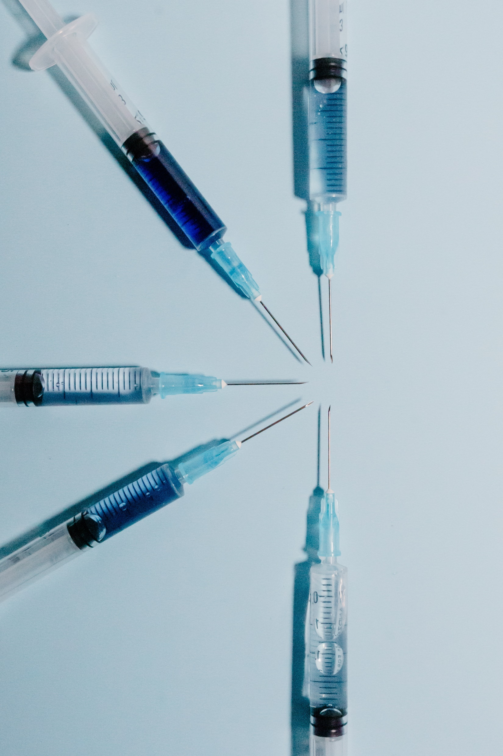
Sharps & Needles
The Methuen Police Station (90 Hampshire Street Methuen, MA) has a needle disposal kiosk located in its lobby for proper disposal of these hazards.
www.cityofmethuen.net/police-department/pages/community-engagement-unit

Slide 23
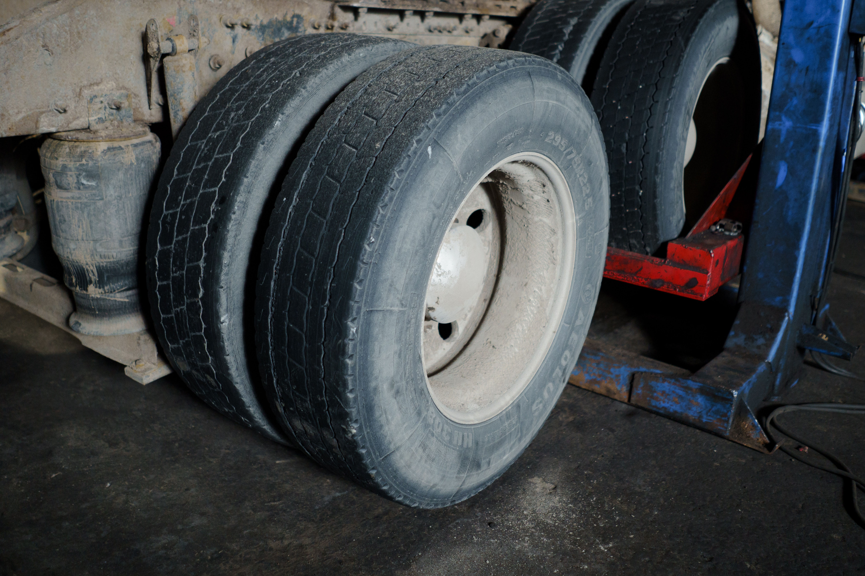
Tires
Broadway Tire Pros (456 Broadway, Lawrence, MA) will accept car tires for $7.00 per tire.
broadwaytire-auto.com
Town Fair Tire(105 South Broadway, Salem, NH) takes up to 10 tires at for a $3.75 fee per tire.
https://www.townfairtire.com/store/tires/new-hampshire/salem/

Slide 24
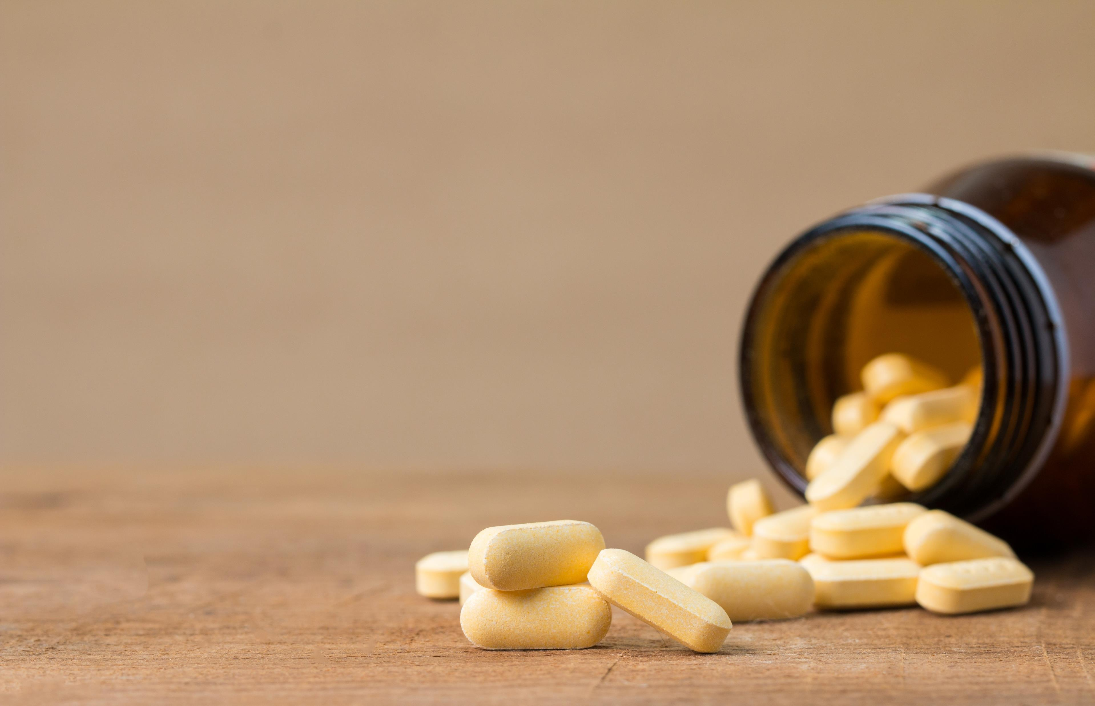
Unwanted or Expired Medication
The Methuen Police Station (90 Hampshire Street Methuen, MA) collects excess medication in its lobby for proper disposal.
www.cityofmethuen.net/police-department/pages/community-engagement-unit

